Slide 1
C# Basic Best Practices
Carlos.Leigue@Jalasoft.com

Slide 2
Agenda
Classes
Naming
Constructors
Namespaces
Static
Accessing
Initialization
Null checking

Slide 3
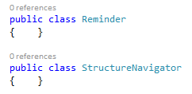
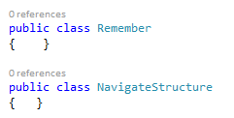
C# Basic Best Practices
Classes
Naming
Define a meaningful name
Use a noun

Slide 4
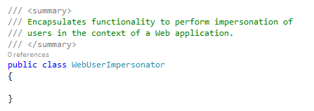
C# Basic Best Practices
Classes
Naming - Documenting
Use Pascal Casing
Add XML documentation

Slide 5
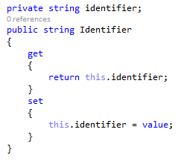
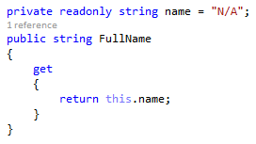
C# Basic Best Practices
Classes
Members
Use properties to encapsulate fields

Slide 6




C# Basic Best Practices
Classes
Members
Use properties to encapsulate fields

Slide 7
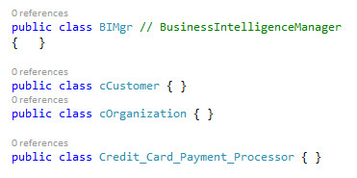
C# Basic Best Practices
Classes
General
One class per code file
Has a well-defined purpose
Add properties above methods
Abbreviations
Prefixes
Underscores
Large classes

Slide 8
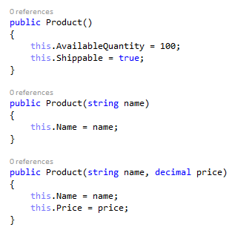
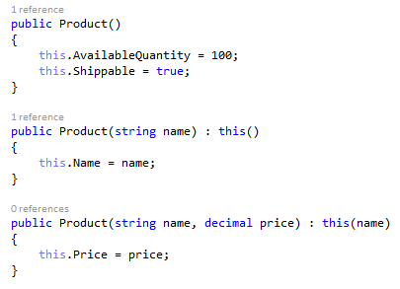
C# Basic Best Practices
Classes
Constructors
Constructor overloading
Use “this” to invoke another constructor
Minimize repeated code (constructor chaining)

Slide 9
C# Basic Best Practices
Classes
Constructors
Consider providing a default constructor
Easier to maintain explicit code
Consider providing a parameterized constructor
Initialize the minimum properties required for a valid object
On parameterized ctors use the same names of the properties for the parameters but using camel case
Performing too much work
Objects construction should not take much time

Slide 10


C# Basic Best Practices
Classes
Namespaces
Use Pascal Casing
<Company>.<Product>.<Feature>
<Company>.<Technology>.<Feature>
Use System.
Use a class name

Slide 11
C# Basic Best Practices
Classes
Static
Cohesive set of services provided by methods (utility methods)
static keyword
Can only have static members
Cannot be instantiated
Use for common code library components, when needed

Slide 12
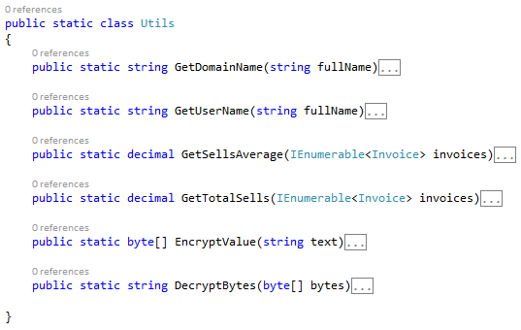
C# Basic Best Practices
Classes
Static
Use as a miscellaneous storage of utilities
Each class should have a clear purpose

Slide 13

C# Basic Best Practices
Classes
References/Using/Accessing
Cautious defining references
We can only have one way references
Take advantage of the using directive
We can use simplified class names

Slide 14


C# Basic Best Practices
Classes
References/Using/Accessing
Do not abuse of the using static directive
Code could get unclear

Slide 15

C# Basic Best Practices
Classes
Initialization
Setting properties
When we populate values from a data source, properties allow us to do conversions and be signaled on errors
When we need to modify the value of the properties after the initialization

Slide 16
C# Basic Best Practices
Classes
Initialization
Parameterized Constructor
When setting the basic set of properties, to have a functional object with a valid state

Slide 17

C# Basic Best Practices
Classes
Initialization
Object Initializer
When initializing a subset or superset of properties
When we want to improve readability

Slide 18
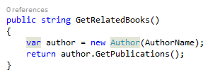
C# Basic Best Practices
Classes
Related objects
Instantiate inside a method
When only the method needs the related object

Slide 19
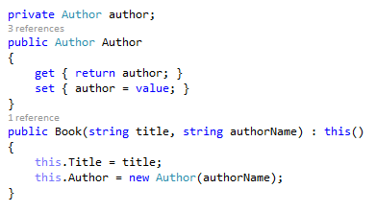
C# Basic Best Practices
Classes
Related objects
Instantiate in the constructor
When the method is needed all over the class (Create a property)

Slide 20
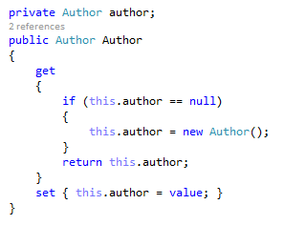
C# Basic Best Practices
Classes
Related objects
Instantiate with lazy loading
When the method is needed just sometimes (initialize in the getter)
When the related objects are heavy or loading them implies long time operations

Slide 21


C# Basic Best Practices
Classes
Null checking
Take advantage of the null-conditional operator

